Slide 1




Airline Safety
Theodore Koby-Hercsky

Slide 2
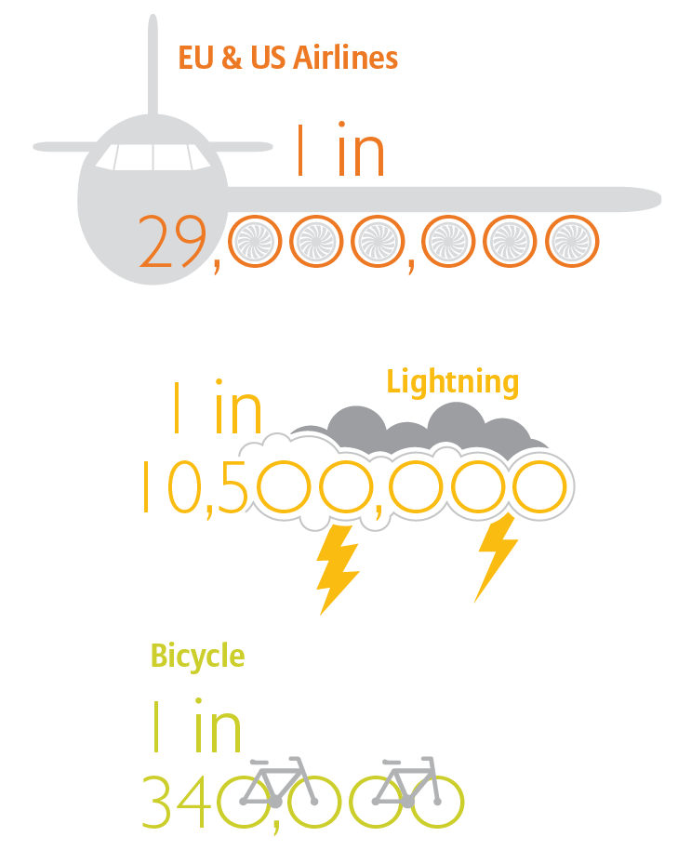
Introduction
Flying said to be the safest form of transportation
Cockpit data monitoring system identify trends and used for training.
Fatal accidents fallen to 0.1 per million

Slide 3

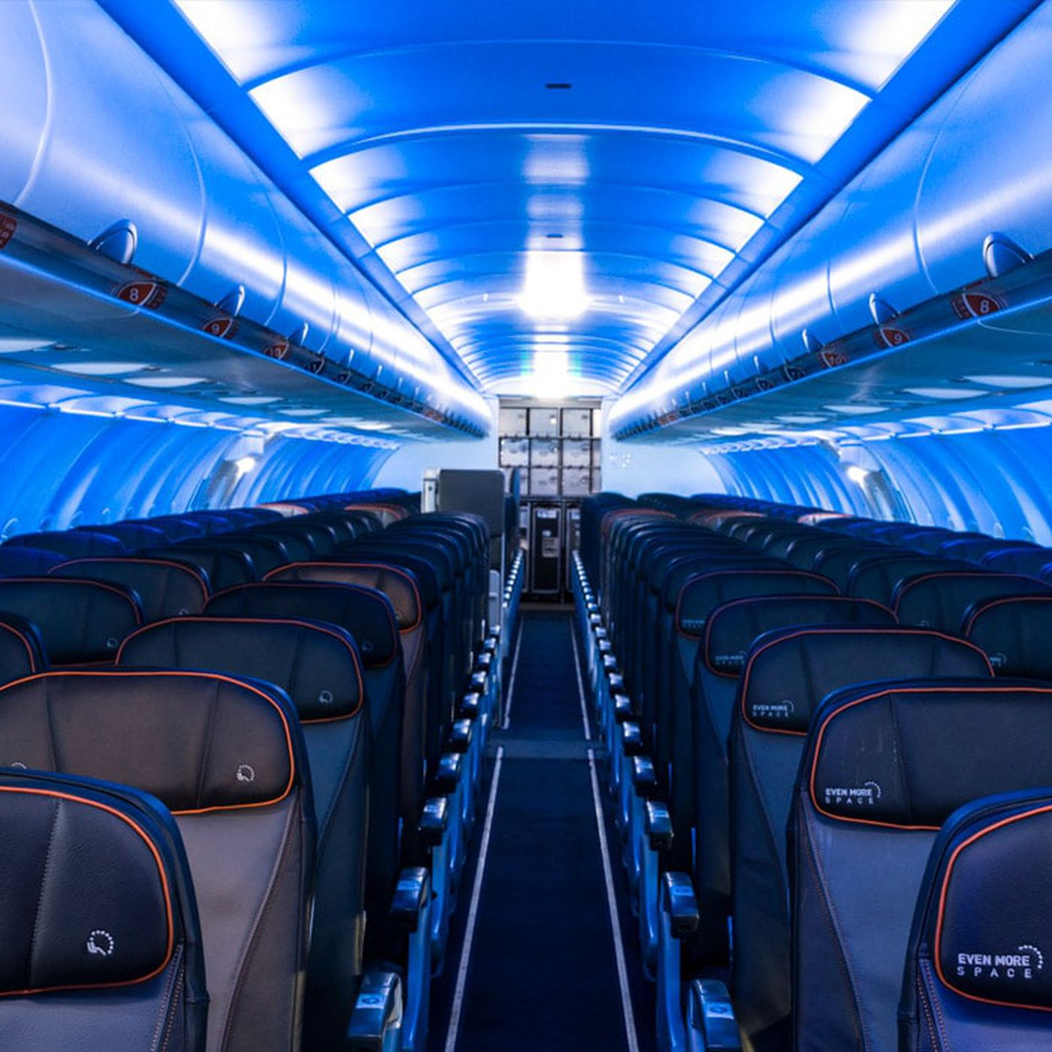

Agenda
Airplane Fatalities & Accidents
Airplane Pre-Tax Profit
Fatalities By Country
Departures & Cargo RTM
Accidents Per Aircraft Type
Fatalities by Airline

Slide 4
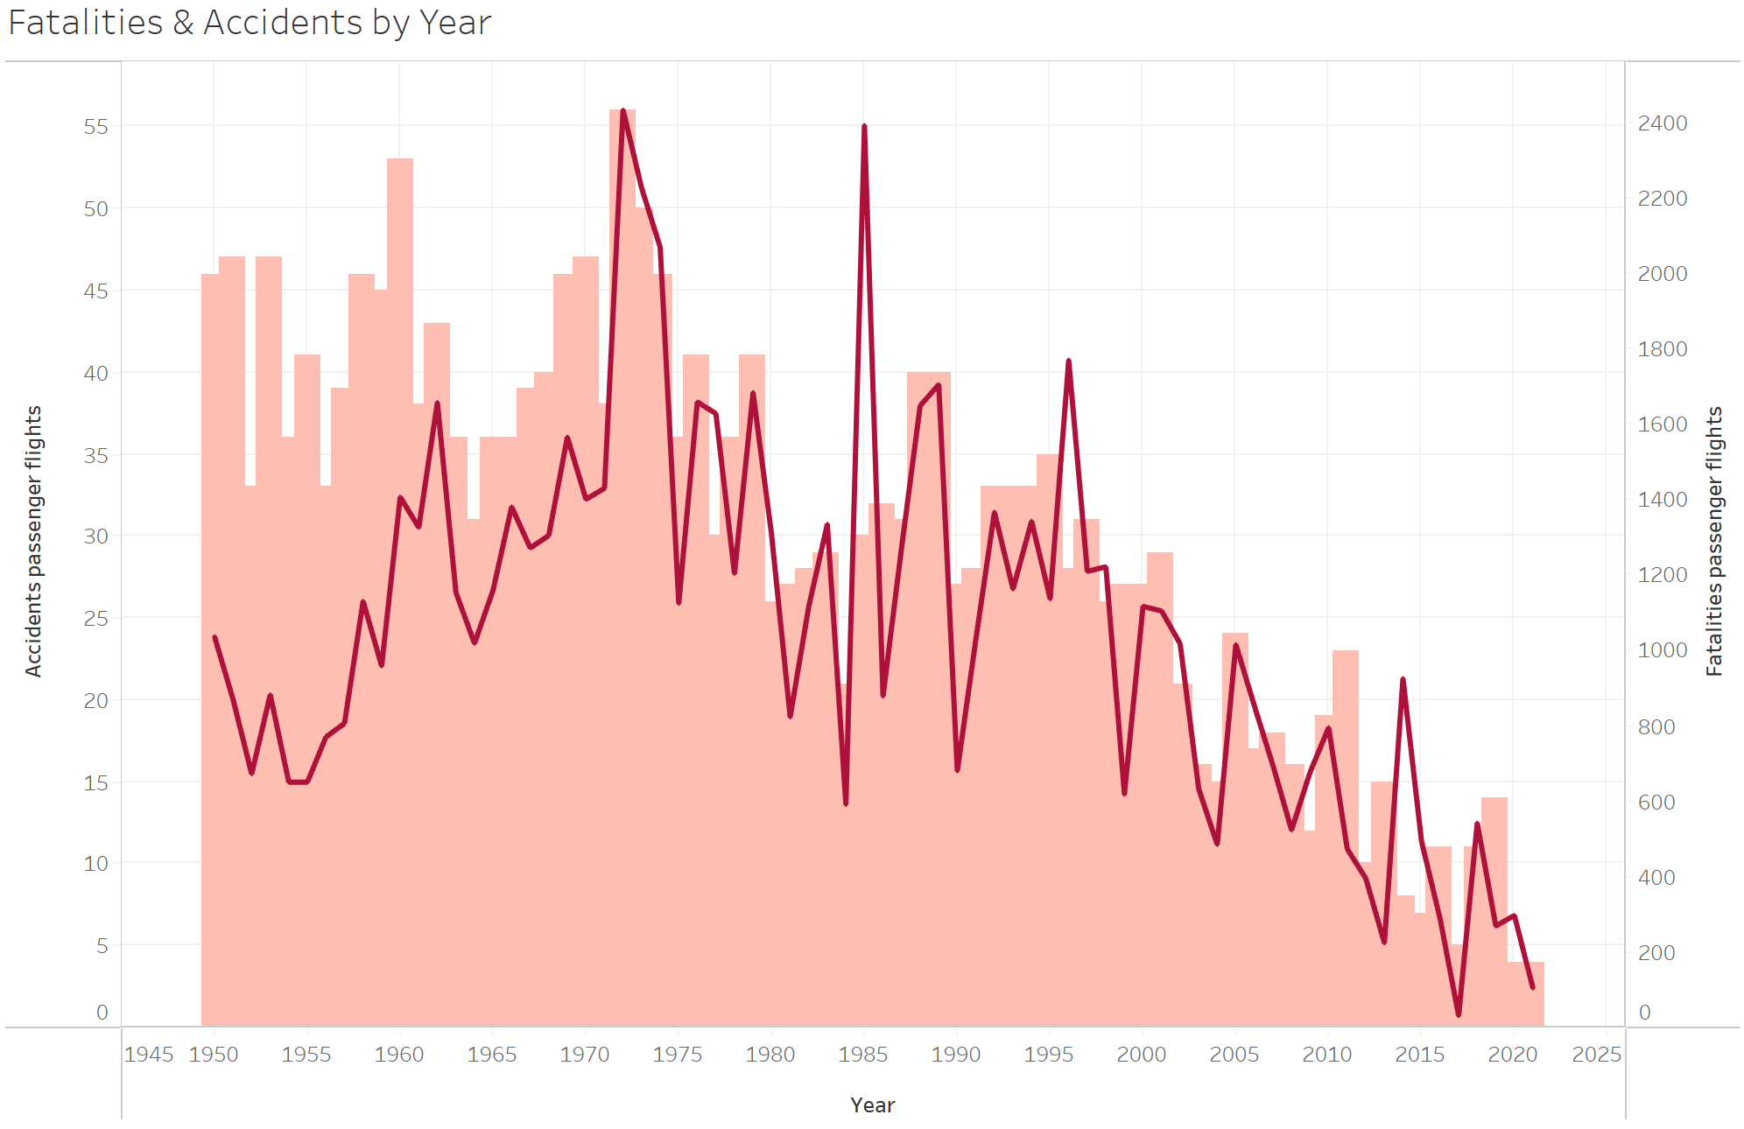
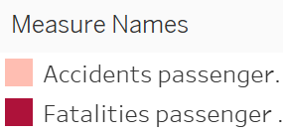
Airplane Fatalities & Accidents by Year
1972 Highest fatalities seen at 2,432 from 56 flights
2021 Lowest fatalities seen at 104 from 4 flights

Slide 5
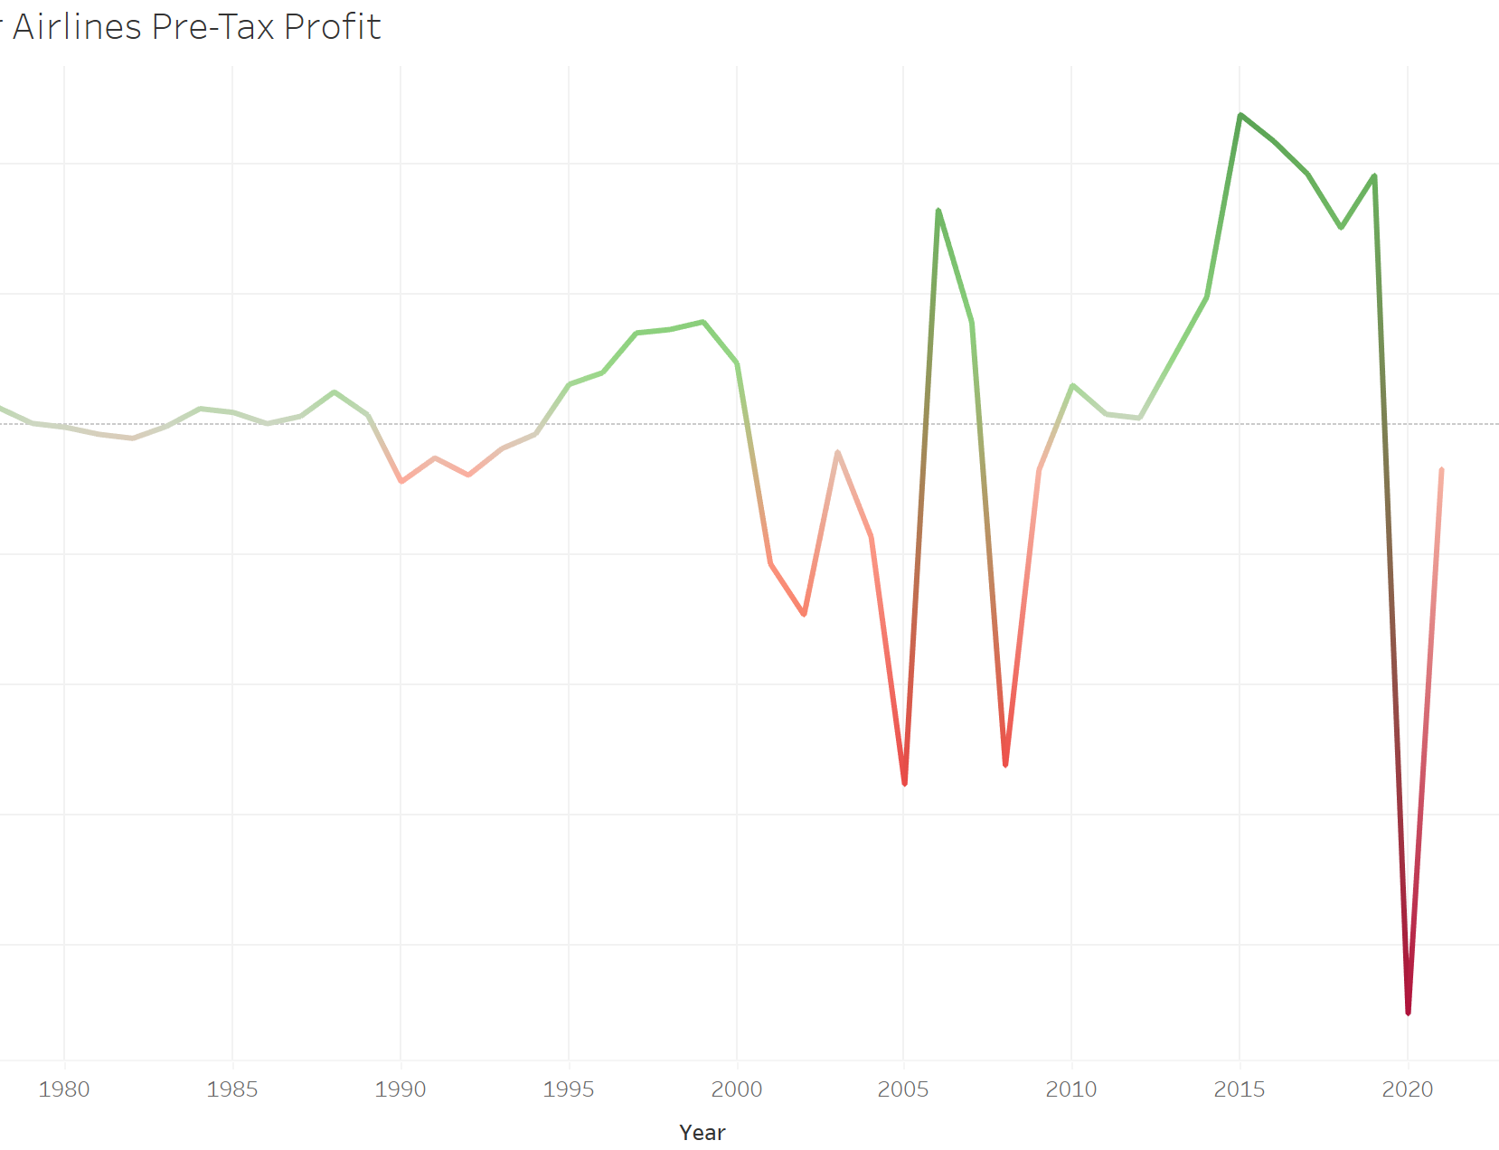
Airplane Pre-Tax Profit
Covid-19 grounded airlines to a screeching halt in 2019
2020 showed a negative pre-tax loss at -$45,232 billion
2022 expected to record a pre-tax loss -9.7 Billion
Industry wide profit estimated for 2023 exceeding pre-pandemic levels

Slide 6
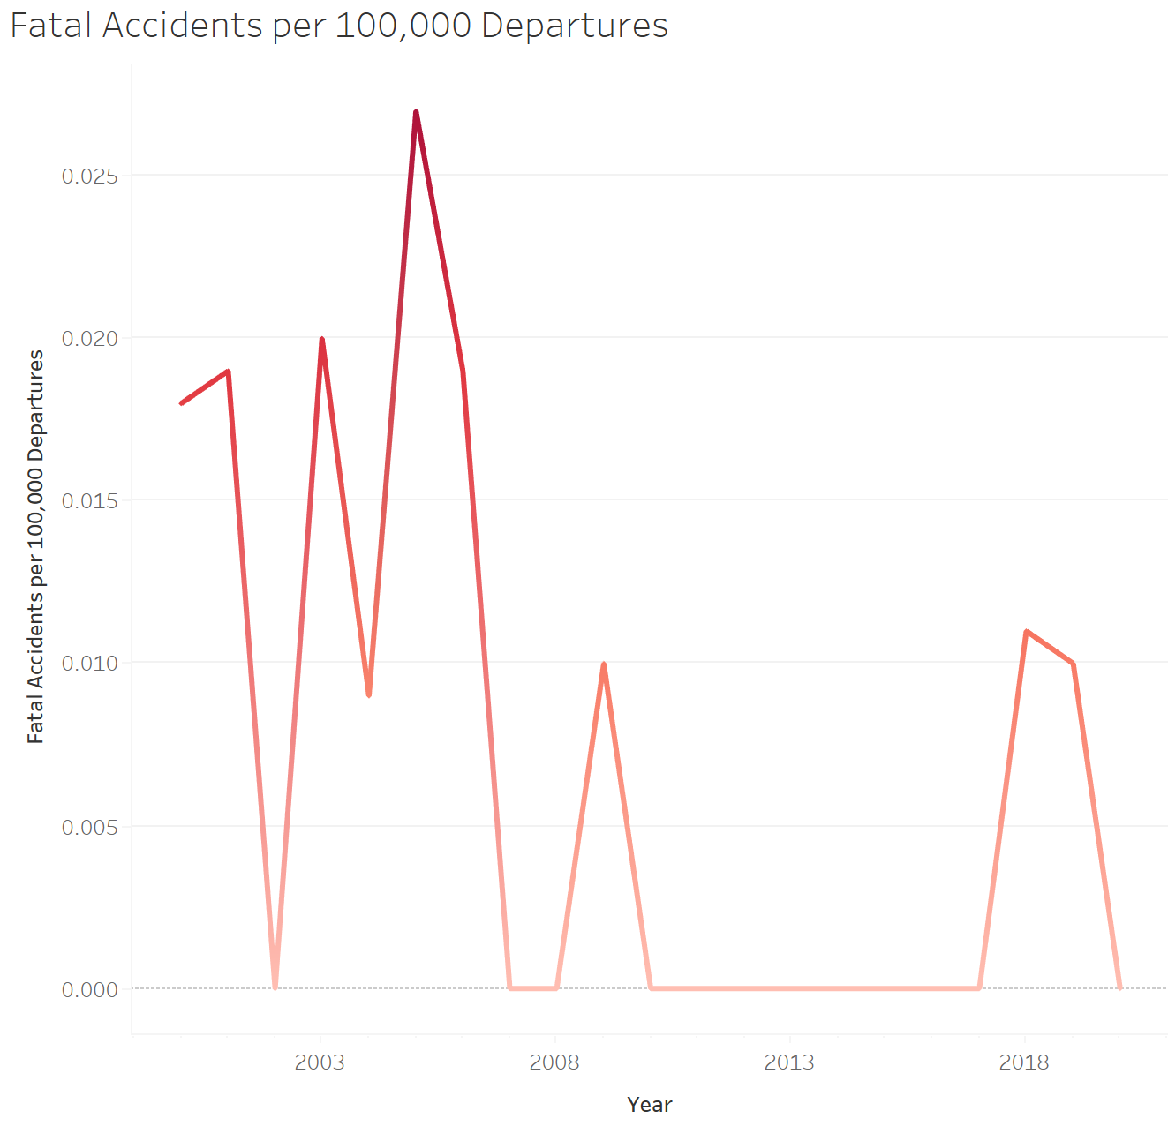
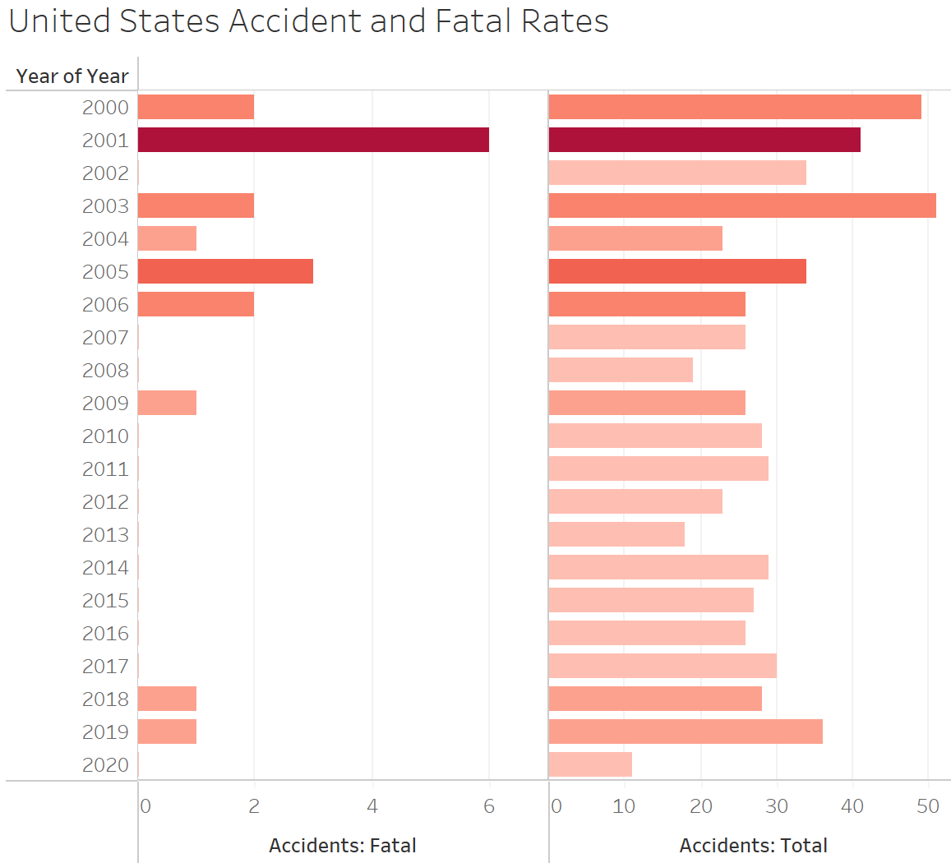
United States Accidents and Fatal Rates
09/01/01 the United States had the largest terrorist attack causing the largest fatality seen.
2005 the United States had the highest fatal accidents per 100,000 departures that sat at 0.027

Slide 7
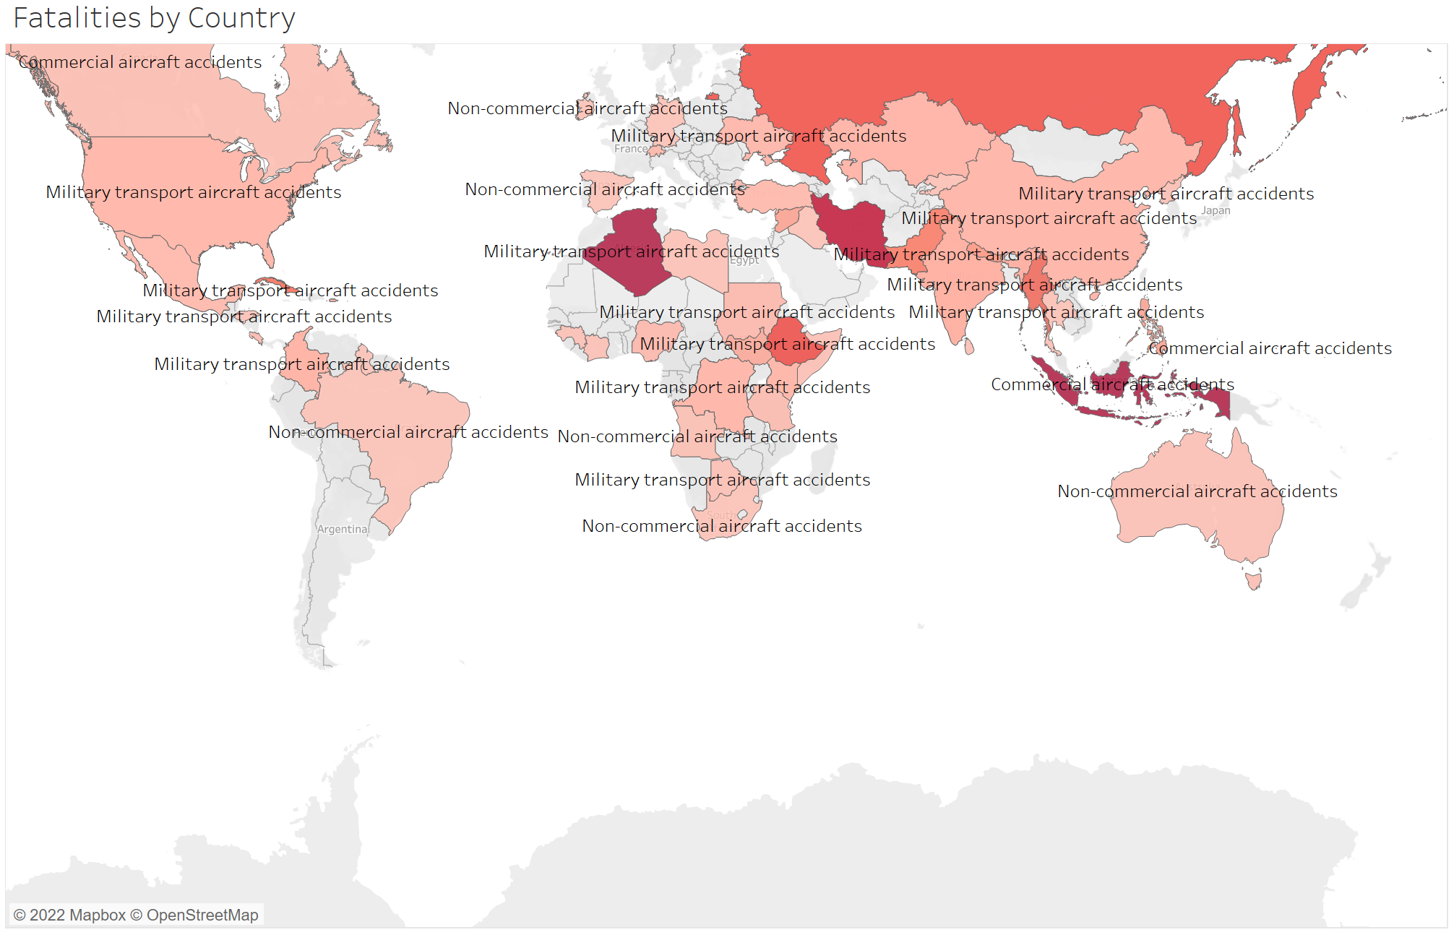
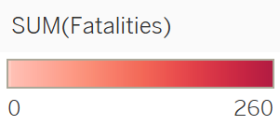
Fatalities By Country
Indonesia 260 commercial aircraft accident fatalities
USA 3 commercial aircraft accident fatalities
Pilot error accounts 53% of aircraft accidents
Mechanical failure 21% of aircraft accidents
Weather conditions 11% of aircraft accidents

Slide 8
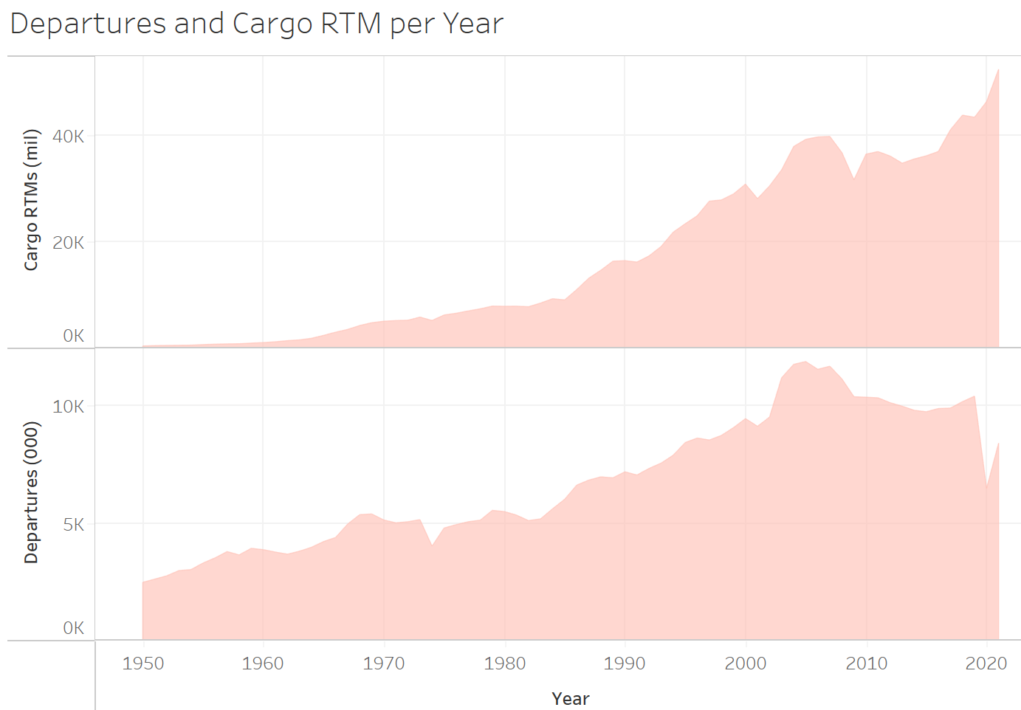
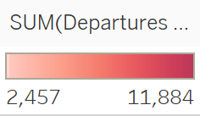
Departures & Cargo RTM per Year
2019 Cargo RTMs 43,474 mil with 10,405 departures Mil
2020 Cargo RTMs 46,429 mil with 6,468 departures Mil
2021 Cargo RTMs 52,530 mil with 8,401 departures Mil

Slide 9
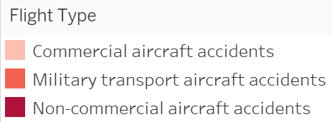
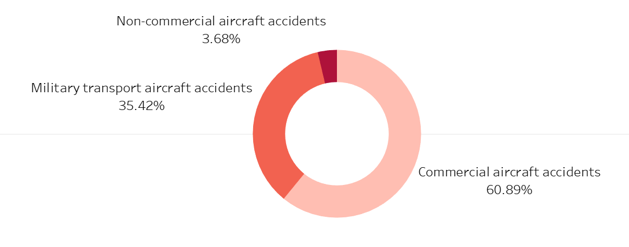
Accidents Per Aircraft Type
Commercial aircraft make up the highest accident percent coming in at 60.89% of all aircraft accidents.
Non-commercial aircraft is seeing only 3.68% accidents.
Push sales in private flights as this is truly the safest way to travel

Slide 10
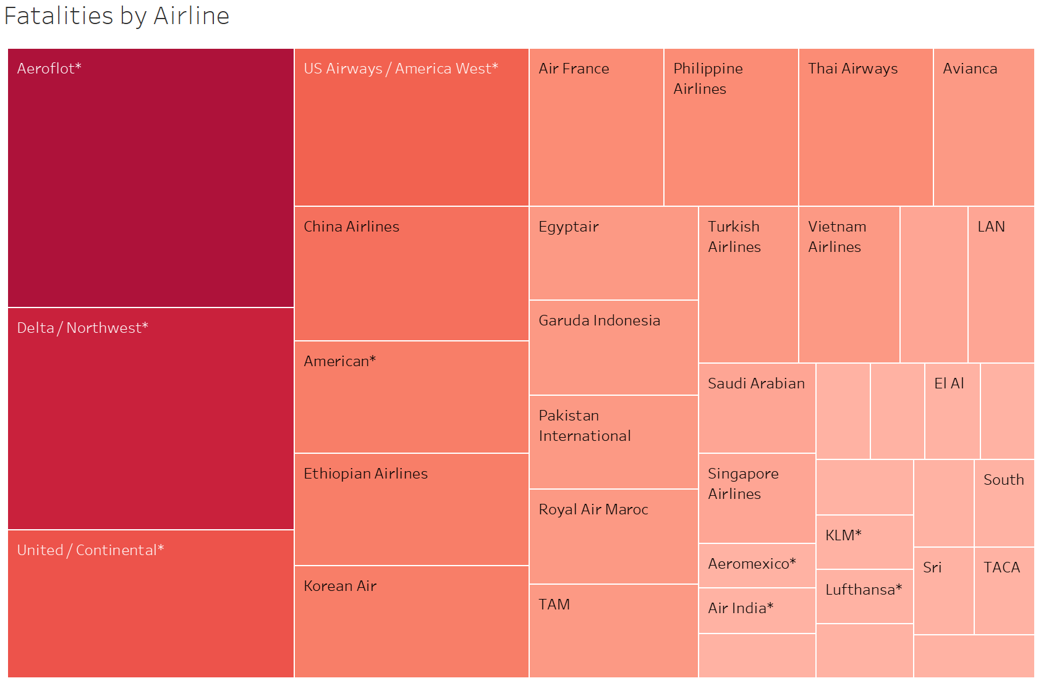
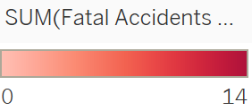
Fatalities by Airline
Aeroflot has the highest number of accidents at 14
Delta / Northwest trails behind with 12 accidents
American shows 5 accidents

Slide 11

Summary
Airplane accidents and fatalities are at the lowest they have seen in decades
Due to Covid-19 all airlines have been grounded and caused record losses from 2019 to 2022 but are expected to see record breaking pre-pandemic estimated profit for the industry
Record breaking Cargo RTMs at 52,530 million in 2021 that is estimated to continue as more products are needed around the world.

Slide 12
Reference
How aviation safety has improved. AGCS Global. (n.d.). Retrieved June 28, 2022, from https://www.agcs.allianz.com/news-and-insights/expert-risk-articles/how-aviation-safety-has-improved.html
Ryan, C. J. and C. (2022, June 21). Airline Industry predicts profit in 2023, defying slowdown. Kennebec Journal and Morning Sentinel. Retrieved June 28, 2022, from https://www.centralmaine.com/2022/06/20/airline-industry-predicts-profit-in-2023-defying-slowdown/
Aviation and plane crash statistics (updated 2022). Panish | Shea | Boyle | Ravipudi LLP. (2022, April 22). Retrieved June 28, 2022, from https://www.psbr.law/aviation_accident_statistics.html

